Slide 1
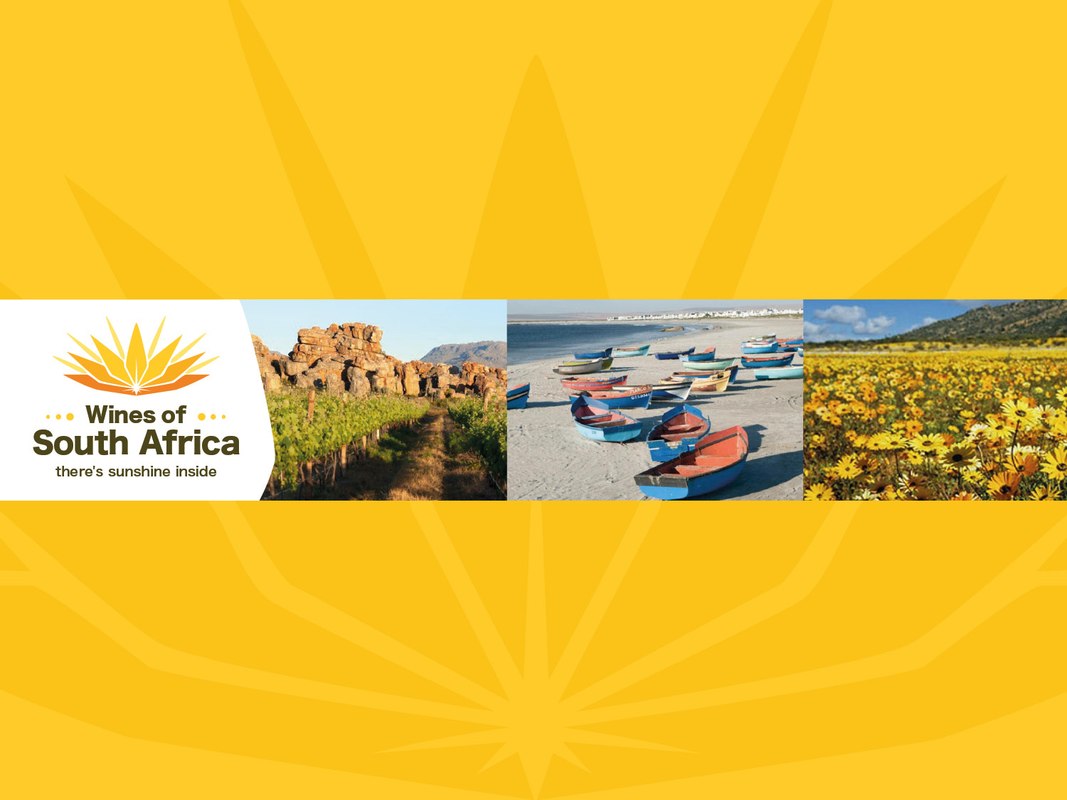
CAPE WINELANDS
OLIFANTS RIVER
Notes:
Wines of South Africa

Slide 2

Where is South Africa?

Slide 3

South Africa is the southernmost
country in Africa.

Slide 4

Our winelands are located at the
very tip of South Africa.

Slide 5

PRODUCTION AREAS: Districts of South Africa.

Slide 6

Wards of South Africa.

Slide 7

Olifants River
Region: Olifants River
District: Citrusdal Mountain
Citrusdal Valley
Wards: Piekenierskloof
Spruitdrift
Vredendal
Region: Coastal
District: Lutzville Valley
Ward: Koekenaap

Slide 8
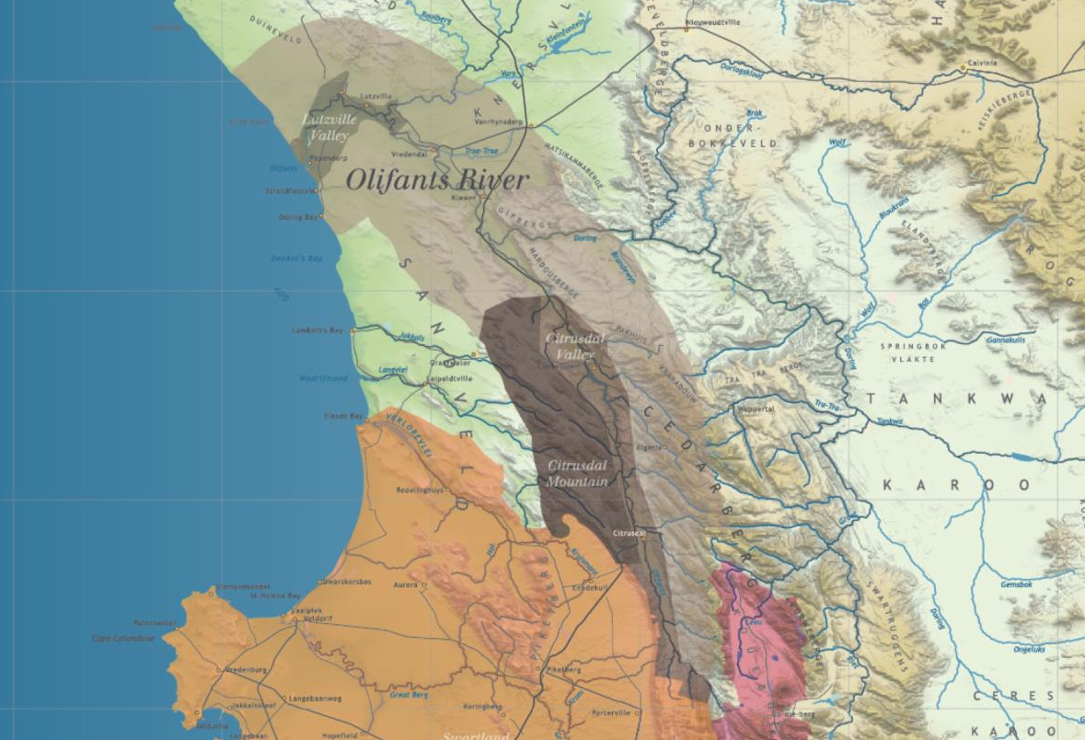
This winegrowing area runs in a belt from north to south along the broad valley of the Olifants River.

Slide 9
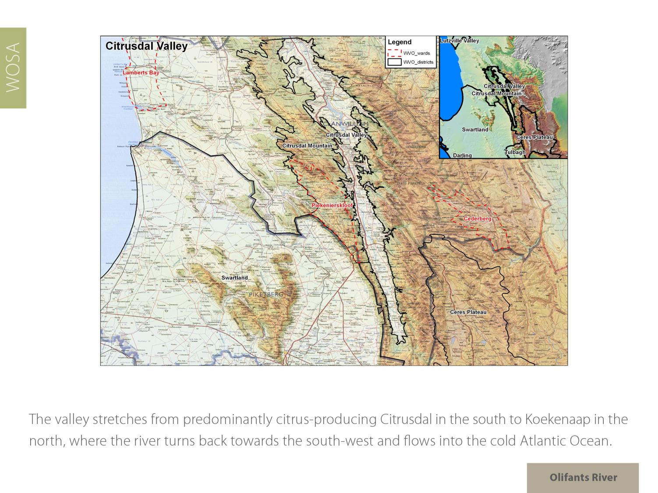
The valley stretches from predominantly citrus-producing Citrusdal in the south to Koekenaap in the north, where the river turns back towards the south-west and flows into the cold Atlantic.

Slide 10
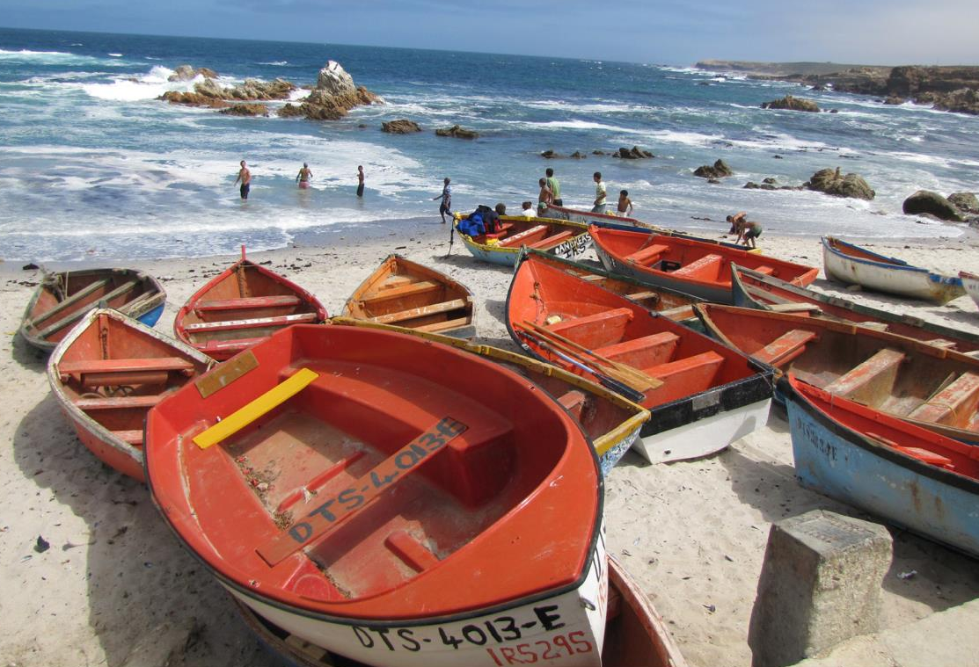
The West Coast Wine Route with its charming fisherman's villages offers numerous outdoor activities including
4x4 routes, quad biking, river rafting, hiking, mountain
biking and camping.

Slide 11
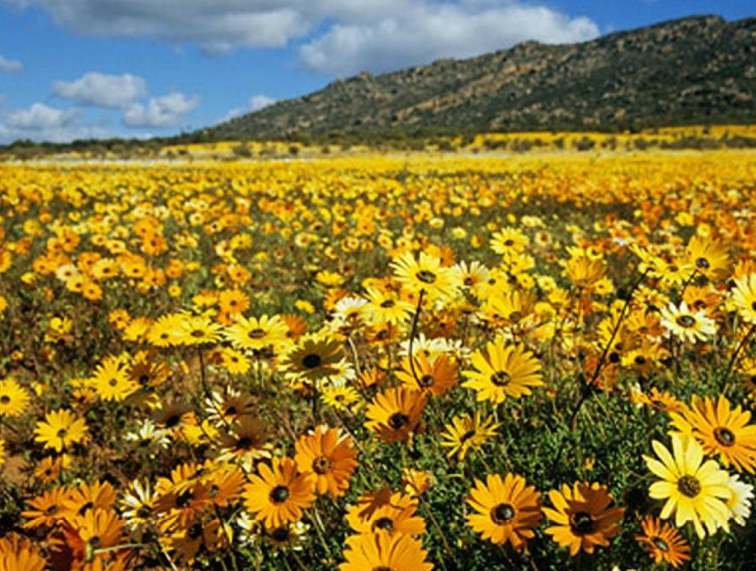
Every year, after the first winter rains, the landscape is transformed into a carpet of veld flowers of every imaginable hue and fragrance, attracting hordes of visitors from far and wide.

Slide 12
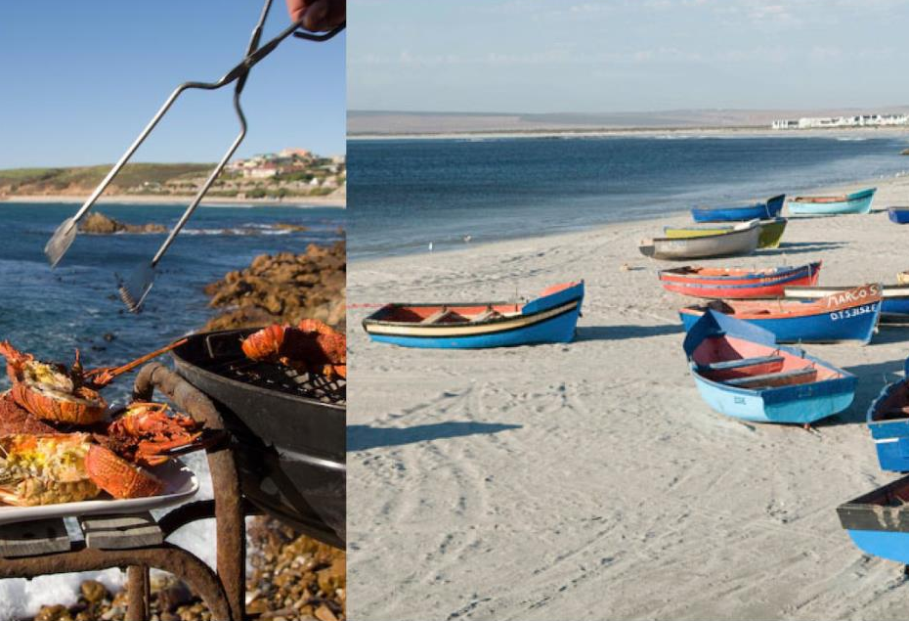
The rugged West Coast has pristine white beaches.

Slide 13
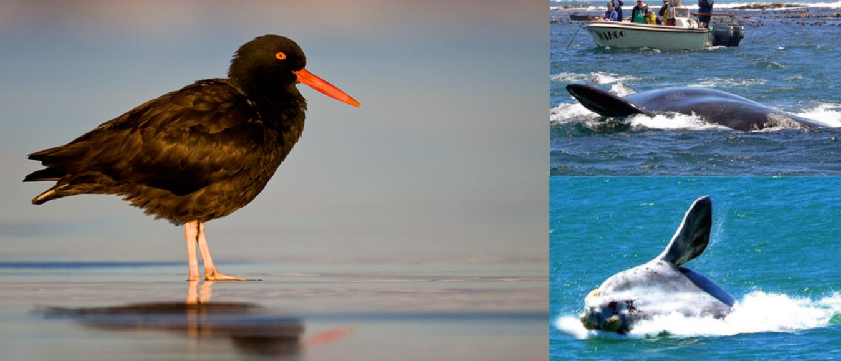
The coastal area is perfect for nature lovers – it's a bird watcher's paradise and, from July each year, whales are regularly spotted in the many small bays.

Slide 14
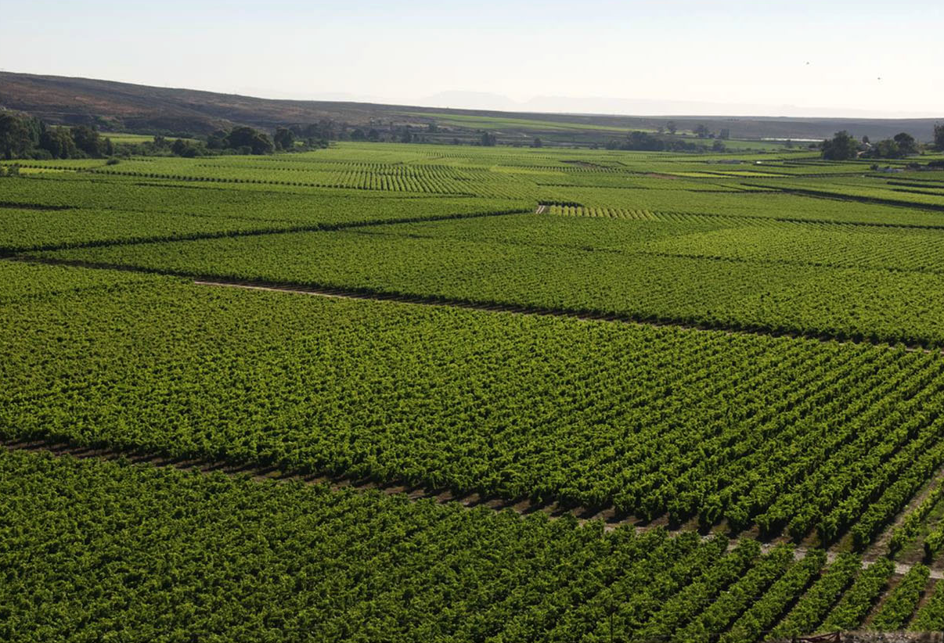
The summers in this valley range from relatively warm to cool compared with some of South Africa’s other wine regions.

Slide 15
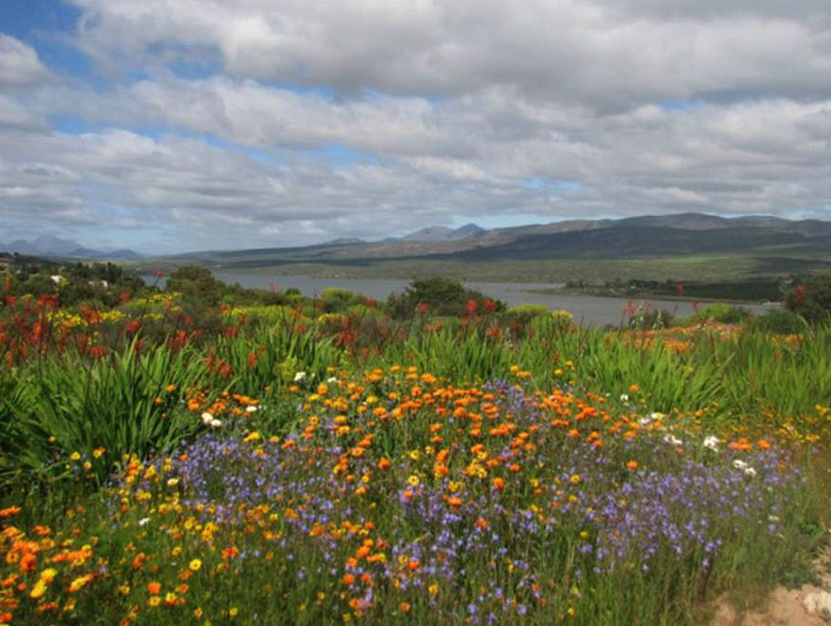
Rainfall in the region is low. The southern part of the valley up until Clanwilliam has an annual average rainfall of 370mm.

Slide 16
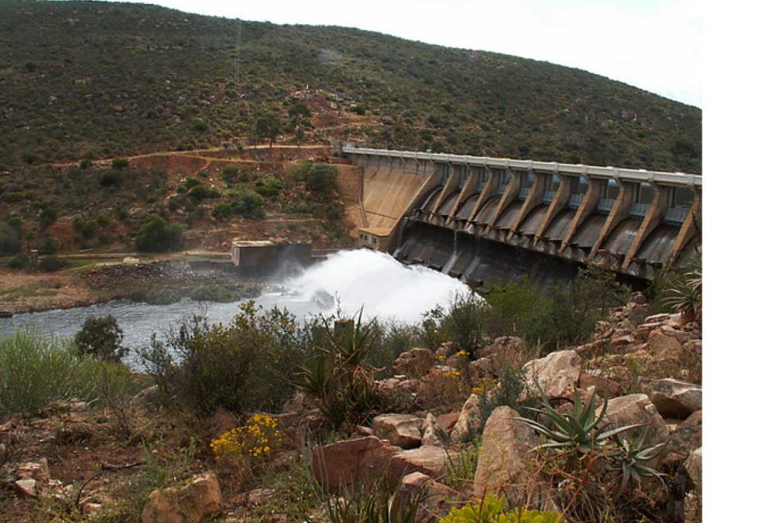
Irrigation is obtained from the Clanwilliam dam, where the water is of an excellent quality.

Slide 17
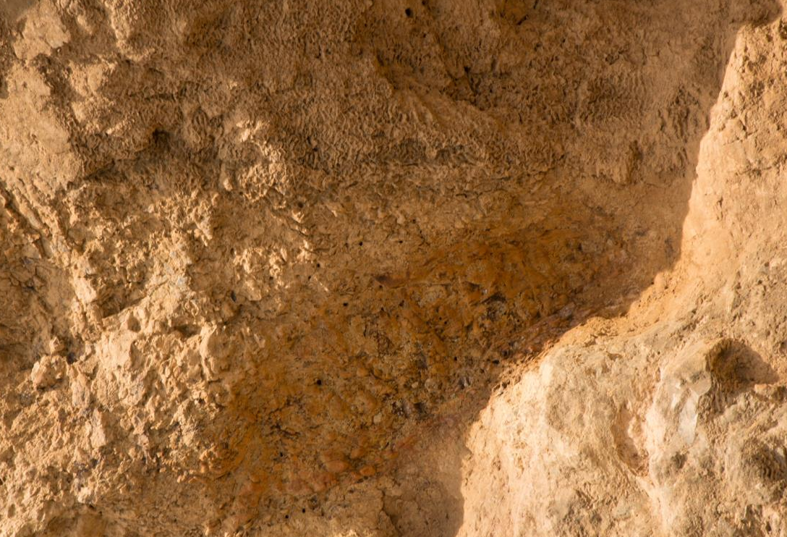
The soils are mainly sandy alluvial soils from the surrounding Table Mountain sandstone mountains.

Slide 18
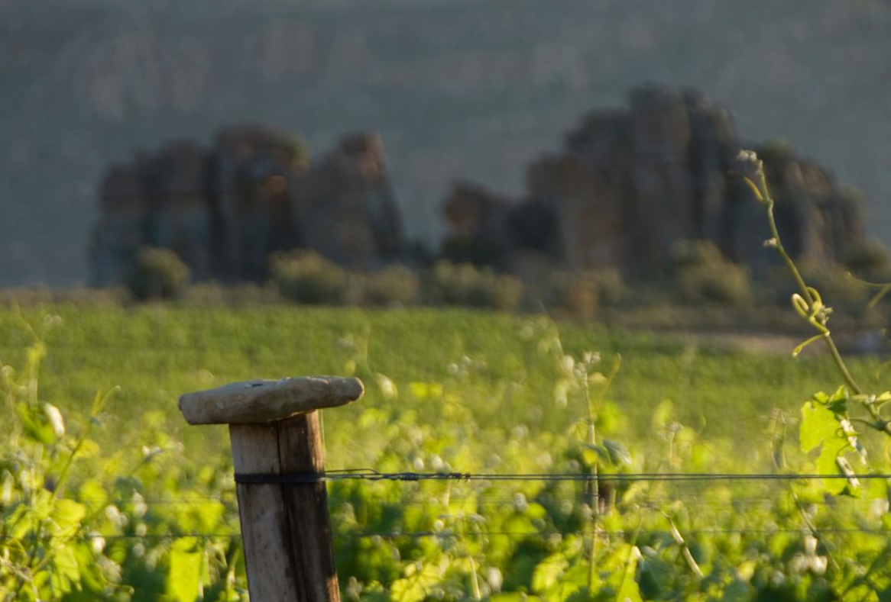
Further north, intensive viticulture takes place.

Slide 19
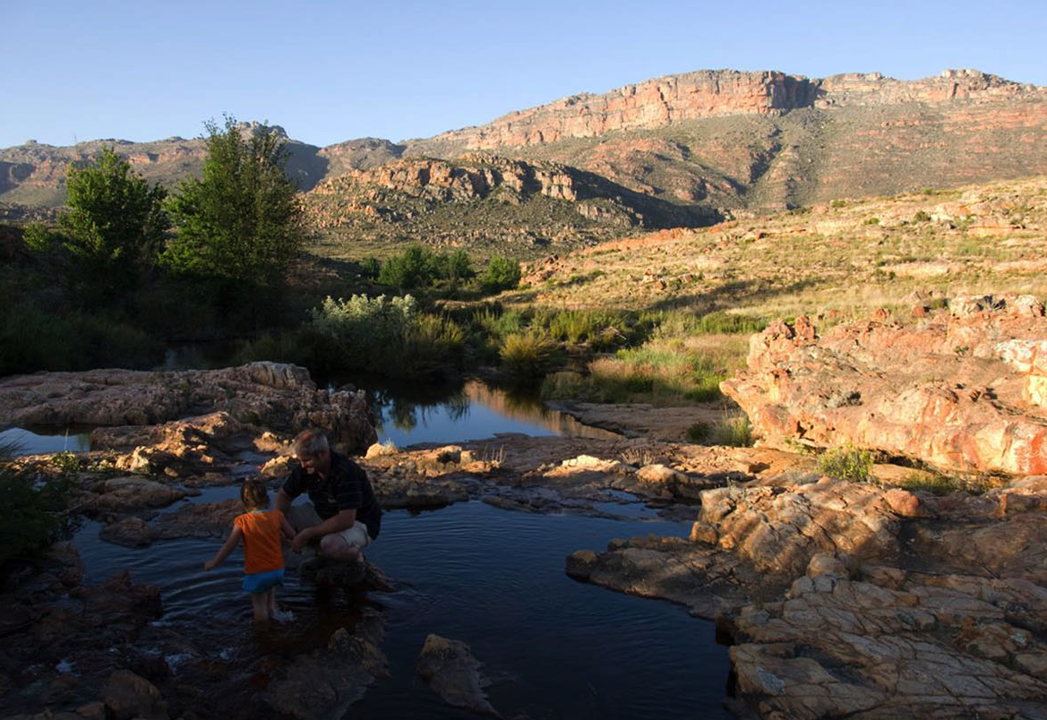
Here the climate is warm and the average annual rainfall is 220 mm.

Slide 20
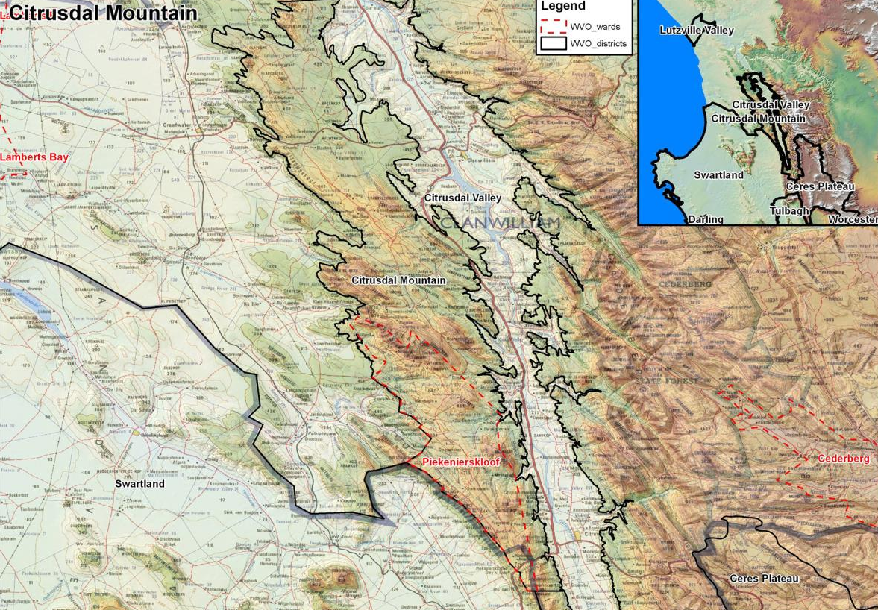
Medium-textured, very fertile alluvial soils are found on the lower river terraces, while reddish-brown, medium-textured, calcareous duripan Karoo soils, similar to those of the Klein Karoo, are found on the higher reaches.

Slide 21
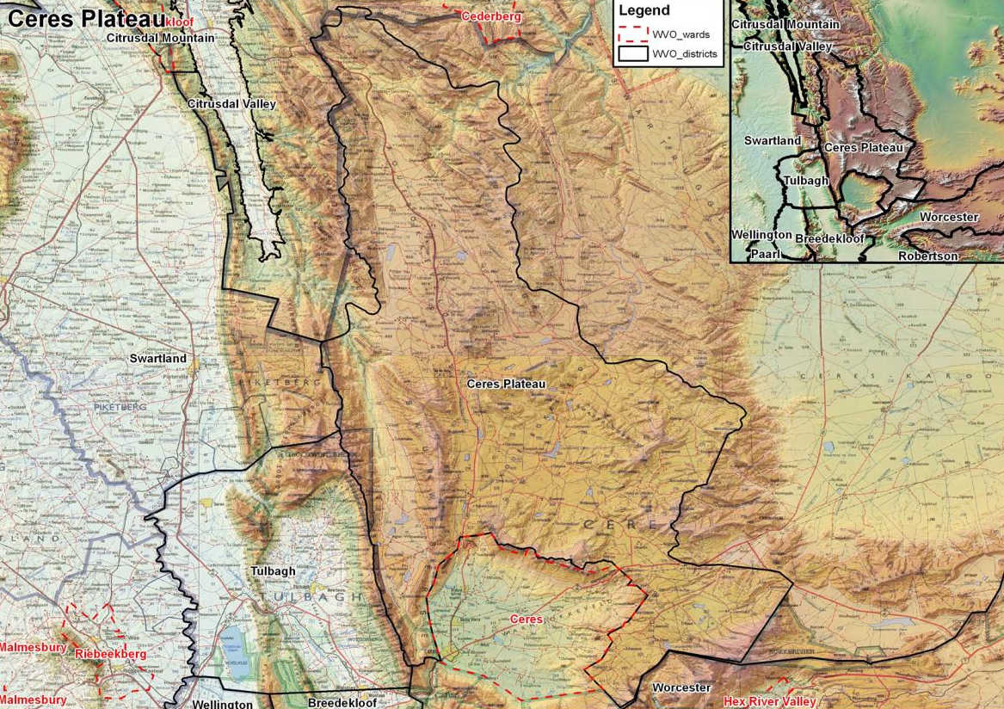
Red windblown sand with underlying calcareous silcrete layers is found in isolated areas on higher landscapes.

Slide 22
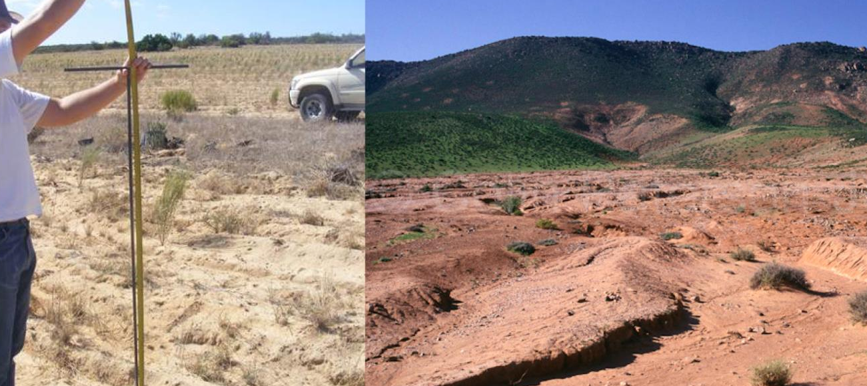
The alluvial and reddish-brown Karoo soils are very rich in cations and phosphate, and often contain free lime.

Slide 23
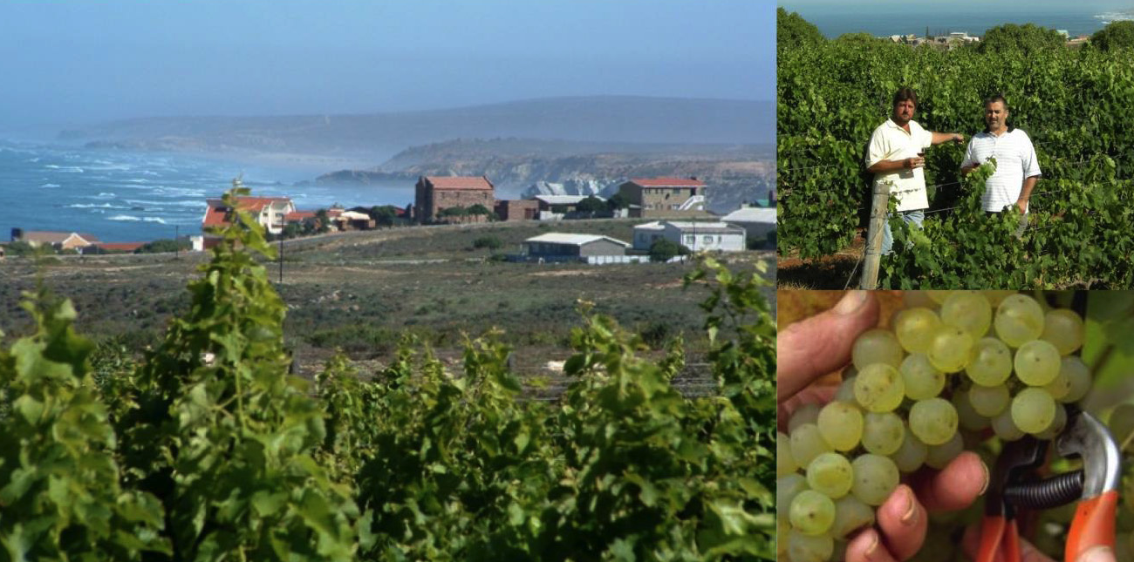
Closer to the cold Atlantic Ocean in the vicinity of Koekenaap vineyards can be found where cooler climates ensure high quality grapes. Further down the coast are the maritime vineyards of the stand-alone ward of Bamboes Bay.

Slide 24
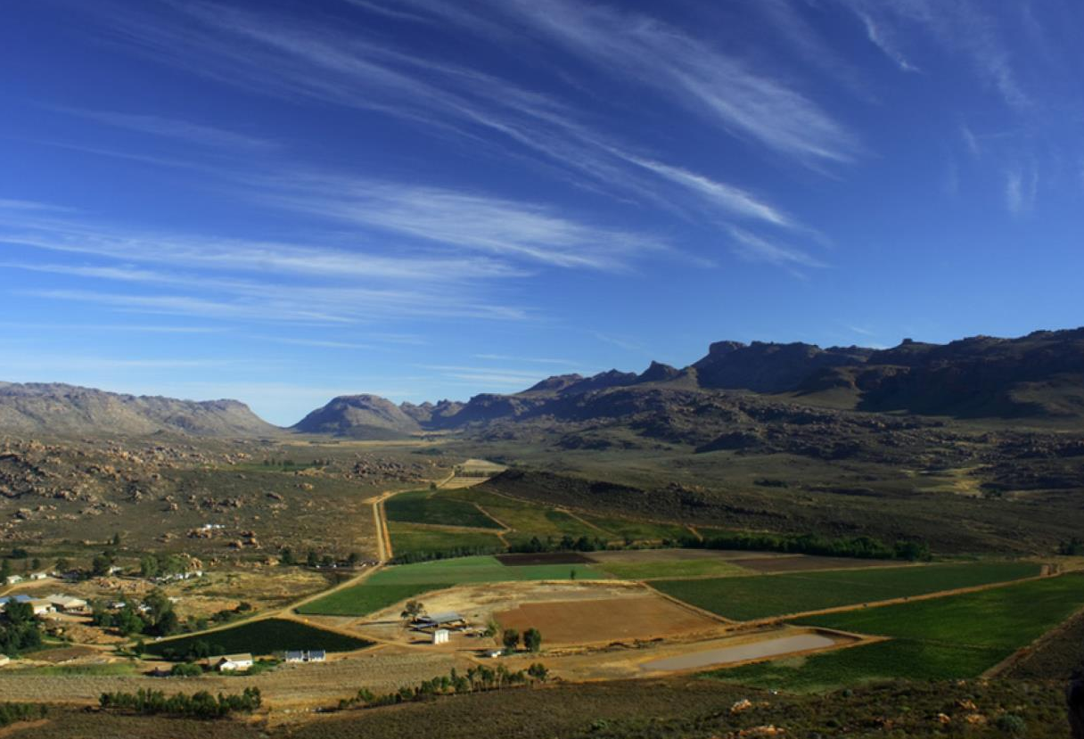
Isolated high-altitude vineyards are found in the high altitude wards of Piekenierskloof and stand-alone Cederberg, where the mean February temperature is 22.8⁰C and rainfall is 473 mm (Stagmanskop Weather Station).

Slide 25
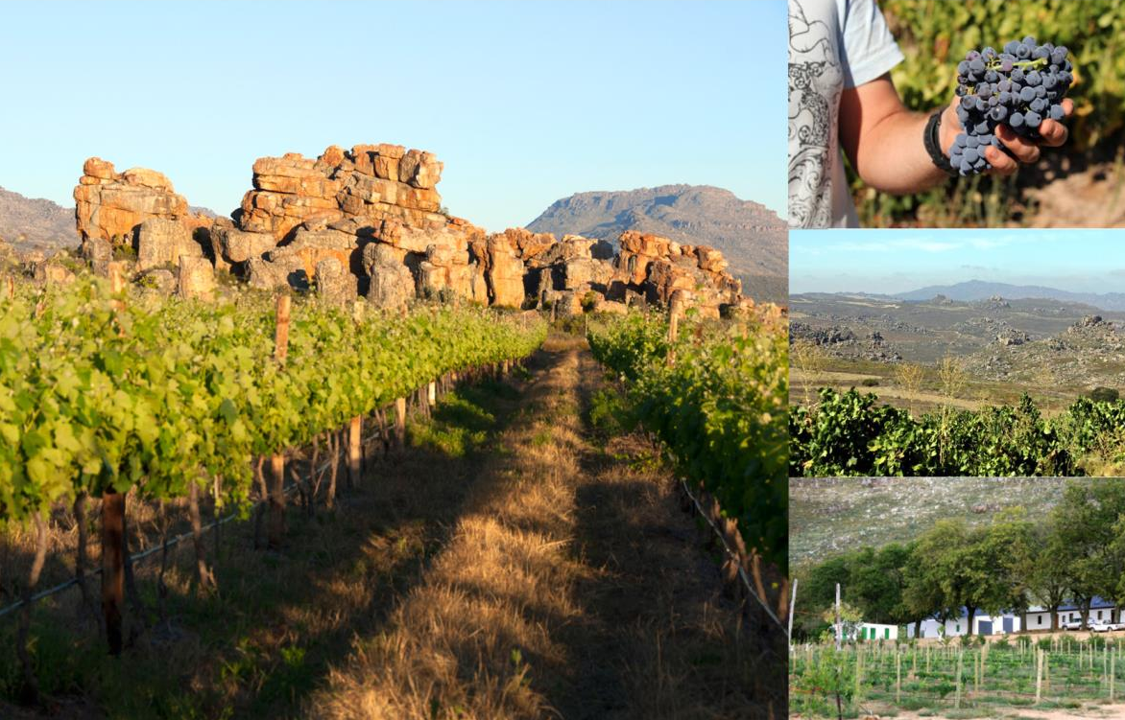
The climate of the high-lying inland ward of Piekenierskloof is conducive to organic cultivation.

Slide 26
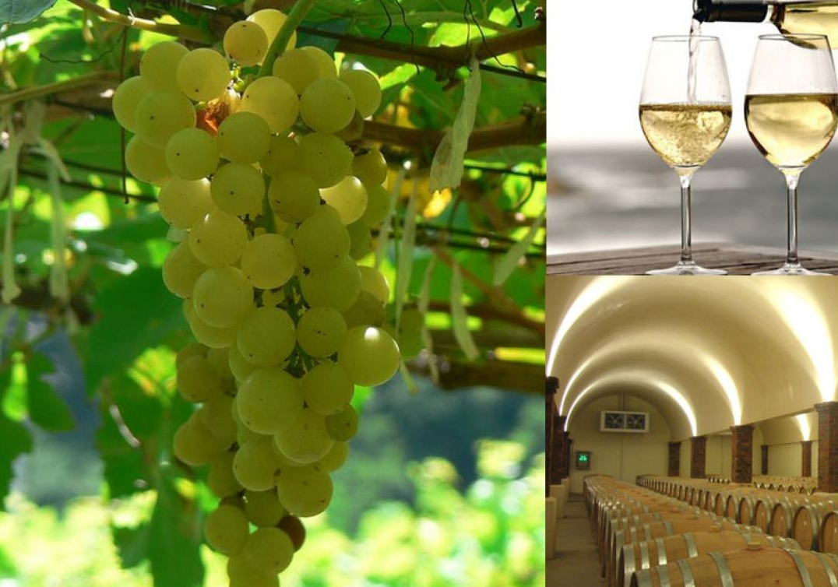
The most planted white-wine variety is Chenin Blanc, followed by Colombard.

Slide 27
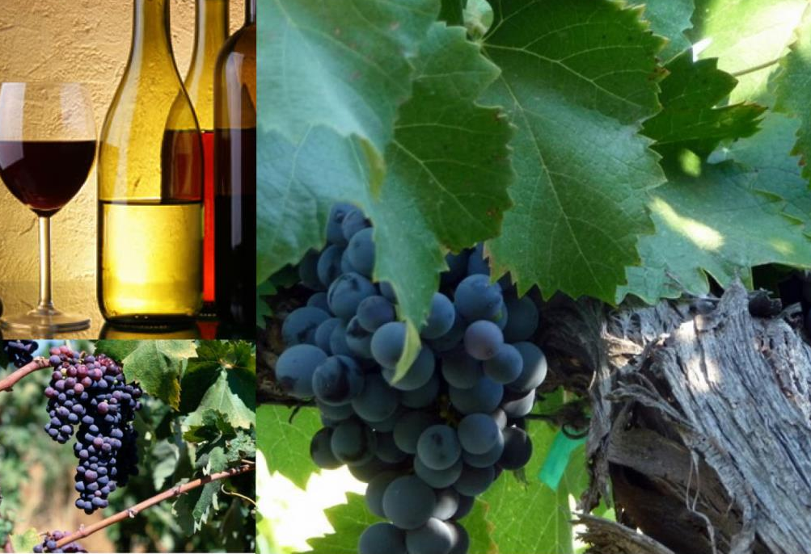
The main red-wine varieties planted are Shiraz, Pinotage and Ruby Cabernet.

Slide 28
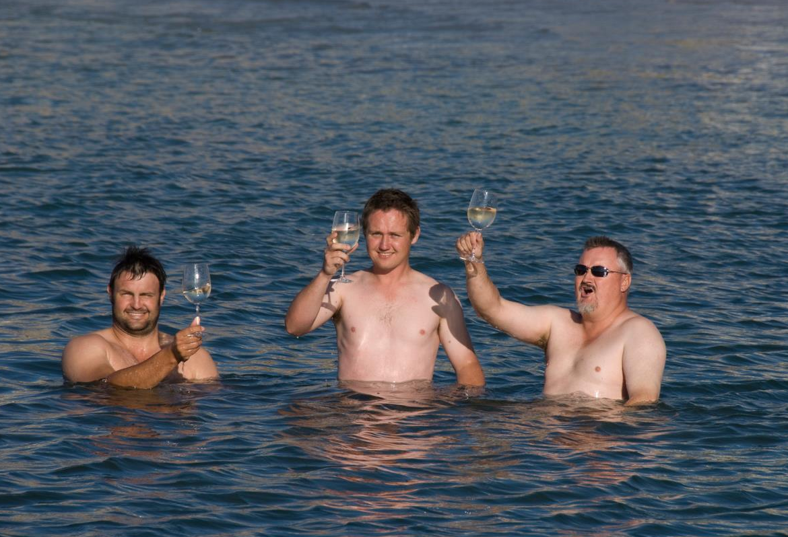
With careful canopy management, which ensures grapes are shaded by the vines leaves, combined with modern winemaking techniques, the Olifants River is proving to be a source of quality, affordable wines.

Slide 29
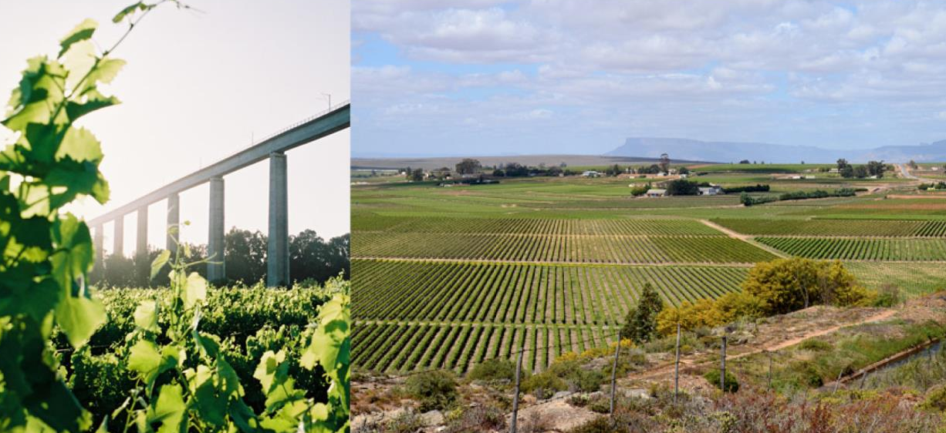
The images used in these presentations have been sourced from various producers, as well as industry and tourism bodies. These presentations are strictly for non-commercial, non-profit, educational purposes only and cannot be reproduced or transmitted in any form or by any means without written permission from Wines of South Africa (WoSA).

Slide 30
The Cape winelands, considered by many to be the most
beautiful in the world, have a network of diverse
and well-run wine routes, affording visitors a varied
and unforgettable experience.
The end
Notes:
The end

